Slide 1
Prime numbers

Slide 2

Prime numbers
Prime numbers are natural numbers greater than $1$, that have
exactly two divisors: $1$ and themselves.

Slide 3
Prime numbers
Prime numbers are natural numbers greater than $1$, that have
exactly two divisors: $1$ and themselves.
Examples of prime numbers: $2, 3, 5, 7, 11, 13, 17, 19$

Slide 4
Prime numbers
Prime numbers are natural numbers greater than $1$, that have
exactly two divisors: $1$ and themselves.
Examples of prime numbers: $2, 3, 5, 7, 11, 13, 17, 19$
Composite numbers are natural numbers greater than $1$, that have
more than two divisors.

Slide 5
Prime numbers
Prime numbers are natural numbers greater than $1$, that have
exactly two divisors: $1$ and themselves.
Examples of prime numbers: $2, 3, 5, 7, 11, 13, 17, 19$
Composite numbers are natural numbers greater than $1$, that have
more than two divisors.
Examples of composite numbers: $4, 6, 8, 9, 10, 15, 57,99$

Slide 6
Prime numbers
Theorem: There are infinitely many prime numbers.

Slide 7
Prime numbers
Theorem: There are infinitely many prime numbers.
Proof: Assume that this is not the case (finitely many prime numbers).

Slide 8

Prime numbers
Theorem: There are infinitely many prime numbers.
Proof: Assume that this is not the case (finitely many prime numbers).
We can then list (name) these prime numbers as:
$$p_{1}=2, p_{2}=3, …, p_{k}=n$$
where $n$ is the largest prime number, and $k$ is its index.

Slide 9
Prime numbers
Theorem: There are infinitely many prime numbers.
Proof: Assume that this is not the case (finitely many prime numbers).
We can then list (name) these prime numbers as:
$$p_{1}=2, p_{2}=3, …, p_{k}=n$$
where $n$ is the largest prime number, and $k$ is its index.
We can construct a number that is the product of all these prime numbers:
$$L=2⋅3⋅…⋅n=p_{1}⋅p_{2}⋅…⋅p_{k}$$

Slide 10
Prime numbers
Theorem: There are infinitely many prime numbers.
Proof: Assume that this is not the case (finitely many prime numbers).
We can then list (name) these prime numbers as:
$$p_{1}=2, p_{2}=3, …, p_{k}=n$$
where $n$ is the largest prime number, and $k$ is its index.
We can construct a number that is the product of all these prime numbers:
$$L=2⋅3⋅…⋅n=p_{1}⋅p_{2}⋅…⋅p_{k}$$
The number $L$ is a composite number and is divisible by all the prime
numbers.

Slide 11
Prime numbers
Theorem: There are infinitely many prime numbers.
Proof: Assume that this is not the case (finitely many prime numbers).
We can then list (name) these prime numbers as:
$$p_{1}=2, p_{2}=3, …, p_{k}=n$$
where $n$ is the largest prime number, and $k$ is its index.
We can construct a number that is the product of all these prime numbers:
$$L=2⋅3⋅…⋅n=p_{1}⋅p_{2}⋅…⋅p_{k}$$
The number $L$ is a composite number and is divisible by all the prime
numbers.
Now let’s put $M=L+1$ – a number one greater than $L$.

Slide 12

Prime numbers
Theorem: There are infinitely many prime numbers.
Proof: Assume that this is not the case (finitely many prime numbers).
We can then list (name) these prime numbers as:
$$p_{1}=2, p_{2}=3, …, p_{k}=n$$
where $n$ is the largest prime number, and $k$ is its index.
We can construct a number that is the product of all these prime numbers:
$$L=2⋅3⋅…⋅n=p_{1}⋅p_{2}⋅…⋅p_{k}$$
The number $L$ is a composite number and is divisible by all the prime
numbers.
Now let’s put $M=L+1$ – a number one greater than $L$.
The number $M$ is greater than $p_{k}$, and it is not divisible by any of the numbers
$$2,3,…,n$$
It has only two divisors – $1$ and itself. A contradiction.

Slide 13
Prime numbers
Theorem: There are infinitely many prime numbers.
Proof: Assume that this is not the case (finitely many prime numbers).
We can then list (name) these prime numbers as:
$$p_{1}=2, p_{2}=3, …, p_{k}=n$$
where $n$ is the largest prime number, and $k$ is its index.
We can construct a number that is the product of all these prime numbers:
$$L=2⋅3⋅…⋅n=p_{1}⋅p_{2}⋅…⋅p_{k}$$
The number $L$ is a composite number and is divisible by all the prime
numbers.
Now let’s put $M=L+1$ – a number one greater than $L$.
The number $M$ is greater than $p_{k}$, and it is not divisible by any of the numbers
$$2,3,…,n$$
It has only two divisors – $1$ and itself. A contradiction.
Therefore, there are infinitely many prime numbers.

Slide 14
Prime numbers
Basic properties:

Slide 15
Prime numbers
Basic properties:
There are infinitely many prime numbers.

Slide 16
Prime numbers
Basic properties:
There are infinitely many prime numbers.
There are infinitely many composite numbers.

Slide 17
Prime numbers
Basic properties:
There are infinitely many prime numbers.
There are infinitely many composite numbers.
$0$ and $1$ are neither prime numbers nor composite numbers.

Slide 18
Prime numbers
Basic properties:
There are infinitely many prime numbers.
There are infinitely many composite numbers.
$0$ and $1$ are neither prime numbers nor composite numbers.
Every composite number can be written as a product of prime numbers,
e.g. $70=2⋅5⋅7$, $100=2⋅2⋅5⋅5=2^{2}⋅5^{2}$

Slide 19
Prime numbers
Basic properties:
There are infinitely many prime numbers.
There are infinitely many composite numbers.
$0$ and $1$ are neither prime numbers nor composite numbers.
Every composite number can be written as a product of prime numbers,
e.g. $70=2⋅5⋅7$, $100=2⋅2⋅5⋅5=2^{2}⋅5^{2}$
There is only one even prime number: $2$.

Slide 20

Prime numbers
Basic properties:
There are infinitely many prime numbers.
There are infinitely many composite numbers.
$0$ and $1$ are neither prime numbers nor composite numbers.
Every composite number can be written as a product of prime numbers,
e.g. $70=2⋅5⋅7$, $100=2⋅2⋅5⋅5=2^{2}⋅5^{2}$
There is only one even prime number: $2$.
All other primes are of the form: $2k+1, k∈ℕ$
for $k>3$ potential primes can only be of the form: $3k+1$, $3k+2$
for $k≥5$ primes can only be of the form: $6k−1, 6k+1$

Slide 21
Prime numbers
Basic properties:
There are infinitely many prime numbers.
There are infinitely many composite numbers.
$0$ and $1$ are neither prime numbers nor composite numbers.
Every composite number can be written as a product of prime numbers,
e.g. $70=2⋅5⋅7$, $100=2⋅2⋅5⋅5=2^{2}⋅5^{2}$
There is only one even prime number: $2$.
All other primes are of the form: $2k+1, k∈ℕ$
for $k>3$ potential primes can only be of the form: $3k+1$, $3k+2$
for $k≥5$ primes can only be of the form: $6k−1, 6k+1$
One of the simplest, yet effective methods for finding prime numbers
is the so-called Sieve of Eratosthenes.

Slide 22
Prime numbers
Finding prime numbers using the Sieve of Eratosthenes:

Slide 23

Prime numbers
Finding prime numbers using the Sieve of Eratosthenes:
$$2, 3, 4, 5, 6, 7, 8, 9, 10, 11, 12, 13, 14, 15, 16, 17, 18, 19, 20, 21, 22, 23, 24, 25, 26, 27, 28, \\ 29, 30, 31, 32, 33, 34, 35, 36, 37, 38, 39, 40, 41, 42, 43, 44, 45, 46, 47, 48, 49, 50, 51, 52, \\ 53, 54, 55, 56, 57, 58, 59, 60, 61, 62, 63, 64, 65, 66, 67, 68, 69, 70, 71, 72, 73, 74, 75, 76, \\ 77, 78, 79, 80, 81, 82, 83, 84, 85, 86, 87, 88, 89, 90, 91, 92, 93, 94, 95, 96, 97, 98, 99, 100$$

Slide 24

Prime numbers
Finding prime numbers using the Sieve of Eratosthenes:
$$2, 3, 4, 5, 6, 7, 8, 9, 10, 11, 12, 13, 14, 15, 16, 17, 18, 19, 20, 21, 22, 23, 24, 25, 26, 27, 28, \\ 29, 30, 31, 32, 33, 34, 35, 36, 37, 38, 39, 40, 41, 42, 43, 44, 45, 46, 47, 48, 49, 50, 51, 52, \\ 53, 54, 55, 56, 57, 58, 59, 60, 61, 62, 63, 64, 65, 66, 67, 68, 69, 70, 71, 72, 73, 74, 75, 76, \\ 77, 78, 79, 80, 81, 82, 83, 84, 85, 86, 87, 88, 89, 90, 91, 92, 93, 94, 95, 96, 97, 98, 99, 100$$

Slide 25
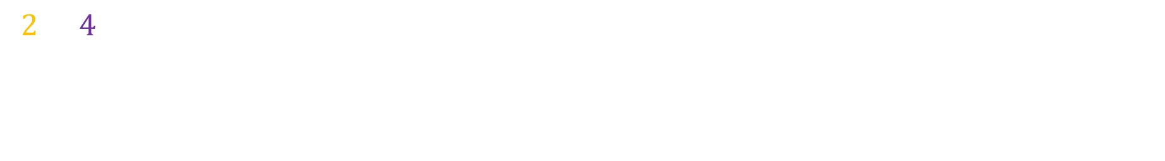
Prime numbers
Finding prime numbers using the Sieve of Eratosthenes:
$$2, 3, 4, 5, 6, 7, 8, 9, 10, 11, 12, 13, 14, 15, 16, 17, 18, 19, 20, 21, 22, 23, 24, 25, 26, 27, 28, \\ 29, 30, 31, 32, 33, 34, 35, 36, 37, 38, 39, 40, 41, 42, 43, 44, 45, 46, 47, 48, 49, 50, 51, 52, \\ 53, 54, 55, 56, 57, 58, 59, 60, 61, 62, 63, 64, 65, 66, 67, 68, 69, 70, 71, 72, 73, 74, 75, 76, \\ 77, 78, 79, 80, 81, 82, 83, 84, 85, 86, 87, 88, 89, 90, 91, 92, 93, 94, 95, 96, 97, 98, 99, 100$$

Slide 26
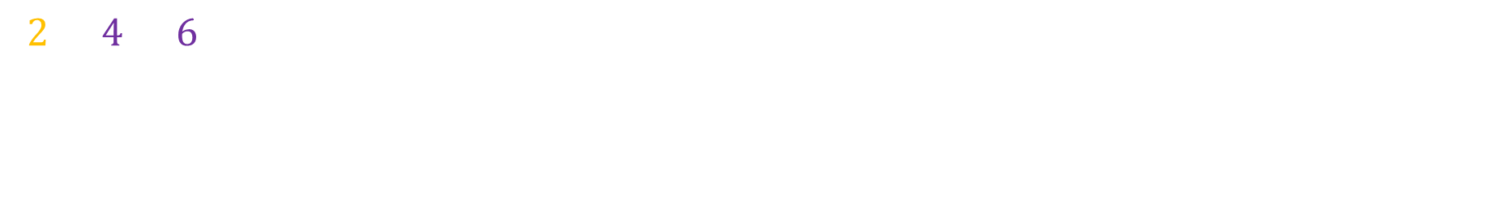
Prime numbers
Finding prime numbers using the Sieve of Eratosthenes:
$$2, 3, 4, 5, 6, 7, 8, 9, 10, 11, 12, 13, 14, 15, 16, 17, 18, 19, 20, 21, 22, 23, 24, 25, 26, 27, 28, \\ 29, 30, 31, 32, 33, 34, 35, 36, 37, 38, 39, 40, 41, 42, 43, 44, 45, 46, 47, 48, 49, 50, 51, 52, \\ 53, 54, 55, 56, 57, 58, 59, 60, 61, 62, 63, 64, 65, 66, 67, 68, 69, 70, 71, 72, 73, 74, 75, 76, \\ 77, 78, 79, 80, 81, 82, 83, 84, 85, 86, 87, 88, 89, 90, 91, 92, 93, 94, 95, 96, 97, 98, 99, 100$$

Slide 27
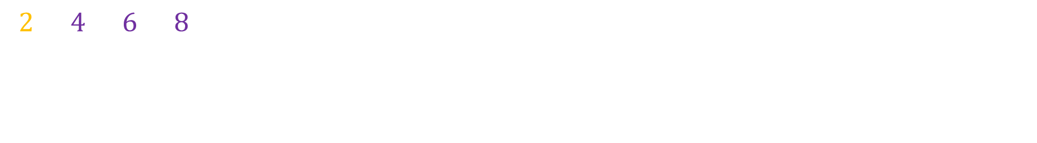
Prime numbers
Finding prime numbers using the Sieve of Eratosthenes:
$$2, 3, 4, 5, 6, 7, 8, 9, 10, 11, 12, 13, 14, 15, 16, 17, 18, 19, 20, 21, 22, 23, 24, 25, 26, 27, 28, \\ 29, 30, 31, 32, 33, 34, 35, 36, 37, 38, 39, 40, 41, 42, 43, 44, 45, 46, 47, 48, 49, 50, 51, 52, \\ 53, 54, 55, 56, 57, 58, 59, 60, 61, 62, 63, 64, 65, 66, 67, 68, 69, 70, 71, 72, 73, 74, 75, 76, \\ 77, 78, 79, 80, 81, 82, 83, 84, 85, 86, 87, 88, 89, 90, 91, 92, 93, 94, 95, 96, 97, 98, 99, 100$$

Slide 28
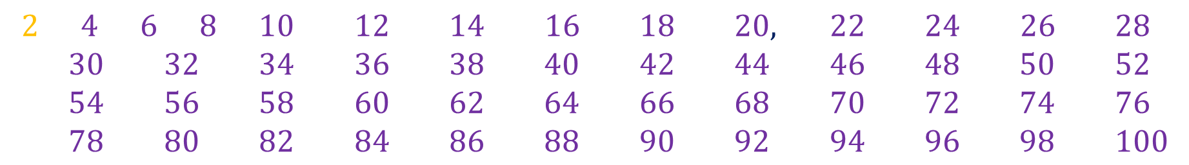
Prime numbers
Finding prime numbers using the Sieve of Eratosthenes:
$$2, 3, 4, 5, 6, 7, 8, 9, 10, 11, 12, 13, 14, 15, 16, 17, 18, 19, 20, 21, 22, 23, 24, 25, 26, 27, 28, \\ 29, 30, 31, 32, 33, 34, 35, 36, 37, 38, 39, 40, 41, 42, 43, 44, 45, 46, 47, 48, 49, 50, 51, 52, \\ 53, 54, 55, 56, 57, 58, 59, 60, 61, 62, 63, 64, 65, 66, 67, 68, 69, 70, 71, 72, 73, 74, 75, 76, \\ 77, 78, 79, 80, 81, 82, 83, 84, 85, 86, 87, 88, 89, 90, 91, 92, 93, 94, 95, 96, 97, 98, 99, 100$$

Slide 29
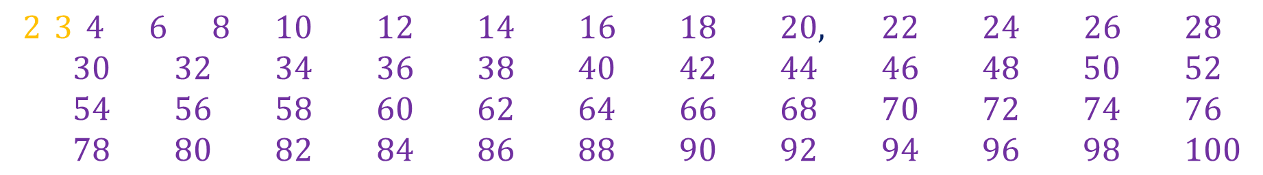
Prime numbers
Finding prime numbers using the Sieve of Eratosthenes:
$$2, 3, 4, 5, 6, 7, 8, 9, 10, 11, 12, 13, 14, 15, 16, 17, 18, 19, 20, 21, 22, 23, 24, 25, 26, 27, 28, \\ 29, 30, 31, 32, 33, 34, 35, 36, 37, 38, 39, 40, 41, 42, 43, 44, 45, 46, 47, 48, 49, 50, 51, 52, \\ 53, 54, 55, 56, 57, 58, 59, 60, 61, 62, 63, 64, 65, 66, 67, 68, 69, 70, 71, 72, 73, 74, 75, 76, \\ 77, 78, 79, 80, 81, 82, 83, 84, 85, 86, 87, 88, 89, 90, 91, 92, 93, 94, 95, 96, 97, 98, 99, 100$$

Slide 30
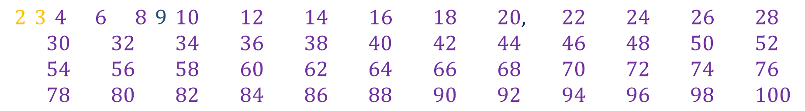
Prime numbers
Finding prime numbers using the Sieve of Eratosthenes:
$$2, 3, 4, 5, 6, 7, 8, 9, 10, 11, 12, 13, 14, 15, 16, 17, 18, 19, 20, 21, 22, 23, 24, 25, 26, 27, 28, \\ 29, 30, 31, 32, 33, 34, 35, 36, 37, 38, 39, 40, 41, 42, 43, 44, 45, 46, 47, 48, 49, 50, 51, 52, \\ 53, 54, 55, 56, 57, 58, 59, 60, 61, 62, 63, 64, 65, 66, 67, 68, 69, 70, 71, 72, 73, 74, 75, 76, \\ 77, 78, 79, 80, 81, 82, 83, 84, 85, 86, 87, 88, 89, 90, 91, 92, 93, 94, 95, 96, 97, 98, 99, 100$$

Slide 31
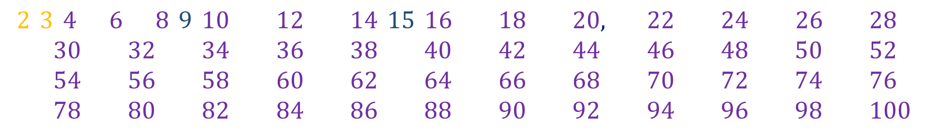
Prime numbers
Finding prime numbers using the Sieve of Eratosthenes:
$$2, 3, 4, 5, 6, 7, 8, 9, 10, 11, 12, 13, 14, 15, 16, 17, 18, 19, 20, 21, 22, 23, 24, 25, 26, 27, 28, \\ 29, 30, 31, 32, 33, 34, 35, 36, 37, 38, 39, 40, 41, 42, 43, 44, 45, 46, 47, 48, 49, 50, 51, 52, \\ 53, 54, 55, 56, 57, 58, 59, 60, 61, 62, 63, 64, 65, 66, 67, 68, 69, 70, 71, 72, 73, 74, 75, 76, \\ 77, 78, 79, 80, 81, 82, 83, 84, 85, 86, 87, 88, 89, 90, 91, 92, 93, 94, 95, 96, 97, 98, 99, 100$$

Slide 32
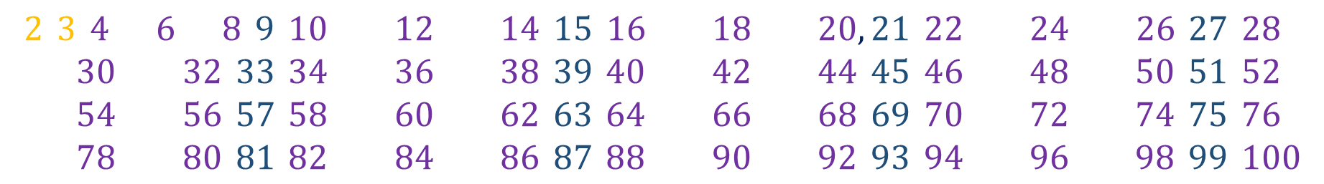
Prime numbers
Finding prime numbers using the Sieve of Eratosthenes:
$$2, 3, 4, 5, 6, 7, 8, 9, 10, 11, 12, 13, 14, 15, 16, 17, 18, 19, 20, 21, 22, 23, 24, 25, 26, 27, 28, \\ 29, 30, 31, 32, 33, 34, 35, 36, 37, 38, 39, 40, 41, 42, 43, 44, 45, 46, 47, 48, 49, 50, 51, 52, \\ 53, 54, 55, 56, 57, 58, 59, 60, 61, 62, 63, 64, 65, 66, 67, 68, 69, 70, 71, 72, 73, 74, 75, 76, \\ 77, 78, 79, 80, 81, 82, 83, 84, 85, 86, 87, 88, 89, 90, 91, 92, 93, 94, 95, 96, 97, 98, 99, 100$$

Slide 33
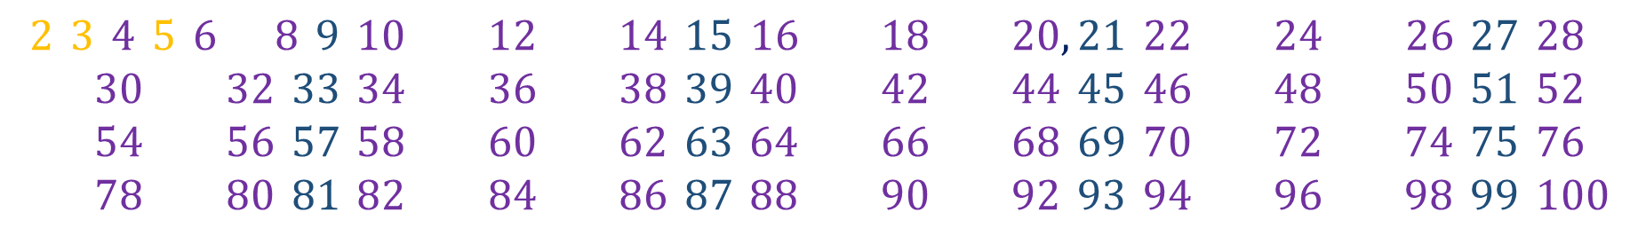
Prime numbers
Finding prime numbers using the Sieve of Eratosthenes:
$$2, 3, 4, 5, 6, 7, 8, 9, 10, 11, 12, 13, 14, 15, 16, 17, 18, 19, 20, 21, 22, 23, 24, 25, 26, 27, 28, \\ 29, 30, 31, 32, 33, 34, 35, 36, 37, 38, 39, 40, 41, 42, 43, 44, 45, 46, 47, 48, 49, 50, 51, 52, \\ 53, 54, 55, 56, 57, 58, 59, 60, 61, 62, 63, 64, 65, 66, 67, 68, 69, 70, 71, 72, 73, 74, 75, 76, \\ 77, 78, 79, 80, 81, 82, 83, 84, 85, 86, 87, 88, 89, 90, 91, 92, 93, 94, 95, 96, 97, 98, 99, 100$$

Slide 34
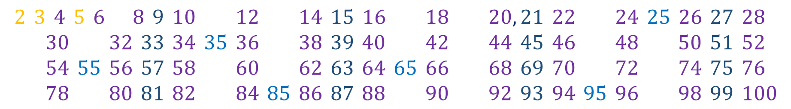
Prime numbers
Finding prime numbers using the Sieve of Eratosthenes:
$$2, 3, 4, 5, 6, 7, 8, 9, 10, 11, 12, 13, 14, 15, 16, 17, 18, 19, 20, 21, 22, 23, 24, 25, 26, 27, 28, \\ 29, 30, 31, 32, 33, 34, 35, 36, 37, 38, 39, 40, 41, 42, 43, 44, 45, 46, 47, 48, 49, 50, 51, 52, \\ 53, 54, 55, 56, 57, 58, 59, 60, 61, 62, 63, 64, 65, 66, 67, 68, 69, 70, 71, 72, 73, 74, 75, 76, \\ 77, 78, 79, 80, 81, 82, 83, 84, 85, 86, 87, 88, 89, 90, 91, 92, 93, 94, 95, 96, 97, 98, 99, 100$$

Slide 35
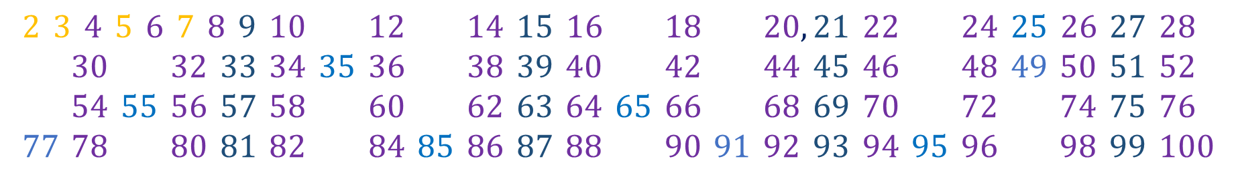
Prime numbers
Finding prime numbers using the Sieve of Eratosthenes:
$$2, 3, 4, 5, 6, 7, 8, 9, 10, 11, 12, 13, 14, 15, 16, 17, 18, 19, 20, 21, 22, 23, 24, 25, 26, 27, 28, \\ 29, 30, 31, 32, 33, 34, 35, 36, 37, 38, 39, 40, 41, 42, 43, 44, 45, 46, 47, 48, 49, 50, 51, 52, \\ 53, 54, 55, 56, 57, 58, 59, 60, 61, 62, 63, 64, 65, 66, 67, 68, 69, 70, 71, 72, 73, 74, 75, 76, \\ 77, 78, 79, 80, 81, 82, 83, 84, 85, 86, 87, 88, 89, 90, 91, 92, 93, 94, 95, 96, 97, 98, 99, 100$$

Slide 36
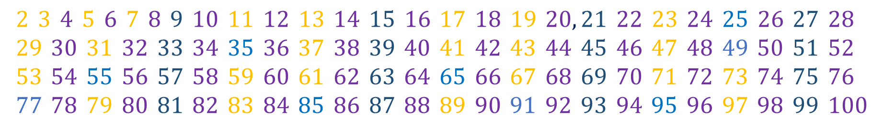
Prime numbers
Finding prime numbers using the Sieve of Eratosthenes:
$$2, 3, 4, 5, 6, 7, 8, 9, 10, 11, 12, 13, 14, 15, 16, 17, 18, 19, 20, 21, 22, 23, 24, 25, 26, 27, 28, \\ 29, 30, 31, 32, 33, 34, 35, 36, 37, 38, 39, 40, 41, 42, 43, 44, 45, 46, 47, 48, 49, 50, 51, 52, \\ 53, 54, 55, 56, 57, 58, 59, 60, 61, 62, 63, 64, 65, 66, 67, 68, 69, 70, 71, 72, 73, 74, 75, 76, \\ 77, 78, 79, 80, 81, 82, 83, 84, 85, 86, 87, 88, 89, 90, 91, 92, 93, 94, 95, 96, 97, 98, 99, 100$$

Slide 37
Prime numbers
To check if a given number is prime, we don't need to try dividing it by all
natural numbers from $2$ to "one less than" the number itself.

Slide 38
Prime numbers
To check if a given number is prime, we don't need to try dividing it by all
natural numbers from $2$ to "one less than" the number itself.
It is enough to try dividing it by prime numbers smaller than it, from $2$
to the square root of the number.
Justification:

Slide 39

Prime numbers
To check if a given number is prime, we don't need to try dividing it by all
natural numbers from $2$ to "one less than" the number itself.
It is enough to try dividing it by prime numbers smaller than it, from $2$
to the square root of the number.
Justification:
There are numbers whose only non-trivial divisor (different than $1$ and the
number itself) is their square root, e.g. $9 = 3⋅3$. These numbers are called
square numbers.

Slide 40
Prime numbers
To check if a given number is prime, we don't need to try dividing it by all
natural numbers from $2$ to "one less than" the number itself.
It is enough to try dividing it by prime numbers smaller than it, from $2$
to the square root of the number.
Justification:
There are numbers whose only non-trivial divisor (different than $1$ and the
number itself) is their square root, e.g. $9 = 3⋅3$. These numbers are called
square numbers.
When dividing a square number by its square root divisor, we obtain the
square root, i.e. $9:3=3$.

Slide 41

Prime numbers
To check if a given number is prime, we don't need to try dividing it by all
natural numbers from $2$ to "one less than" the number itself.
It is enough to try dividing it by prime numbers smaller than it, from $2$
to the square root of the number.
Justification:
There are numbers whose only non-trivial divisor (different than $1$ and the
number itself) is their square root, e.g. $9 = 3⋅3$. These numbers are called
square numbers.
When dividing a square number by its square root divisor, we obtain the
square root, i.e. $9:3=3$. If there is a divisor greater than the square root
(e.g., $8$ has a divisor of $4$), dividing will give a number smaller than
the square root ($8:4=2$), since dividing by a larger number gives a smaller
result.

